Slide 1
Aʀᴅᴜɪɴᴏ Cᴏᴍᴍᴜɴɪᴄᴀᴛɪᴏɴ : I2C ᴍᴀsᴛᴇʀ-sʟᴀᴠᴇ sᴇᴛᴜᴘ
ᴇғғᴏʀᴛʟᴇss ᴅᴀᴛᴀ ᴛʀᴀɴsғᴇʀ ʙᴇᴛᴡᴇᴇɴ ᴛᴡᴏ ᴀʀᴅᴜɪɴᴏ ʙᴏᴀʀᴅs

Slide 2
Table of Contents
I2C Communication Using Arduino (Introduction)
Components Required
Circuit Diagram
Working Principle
Code implementation
Testing and Results
Conclusion
References

Slide 3
I2C Communication Using Arduino :
In the realm of Arduino-based projects, efficient communication between devices is paramount, and the I2C (Inter-Integrated Circuit) protocol stands as a key player. This tutorial, "I2C Communication Using Arduino," delves into the intricacies of establishing communication between Arduino boards or other I2C-compatible devices. Whether configuring one Arduino as the master and another as the slave or connecting multiple devices in a network, this guide provides insights into the setup and programming essentials. Unlock the potential of I2C to seamlessly send and receive data, fostering a more interconnected and responsive Arduino ecosystem. Join us on this journey to harness the power of I2C communication within the versatile Arduino framework.

Slide 4
Components Required :
Arduino UNO Board (2): The Arduino UNO board, powered by the ATmega328P chip, serves as the central control unit. It includes 14 digital input/output pins, 6 analog input pins, and various connectors such as USB, power jack, ICSP header, and a reset button.
LED Bulb : The led bulb having two terminals Anode and Cathode It has produces light when an electric current passes through it.
Resistor : The resistor regulates the flow of electric current and reduces voltage in the circuit.
Push Button and Resistors (2x 220 Ohm): The push button offers user interactivity, while the two 220-ohm resistors ensure proper current limiting for the LED, preventing excessive current flow and enhancing the durability of the electronic components.
Connecting Wires : Different-colored wires (e.g., red for positive voltage, black for ground, yellow for signals) establish connections within the circuit, ensuring proper functionality and organization.

Slide 5
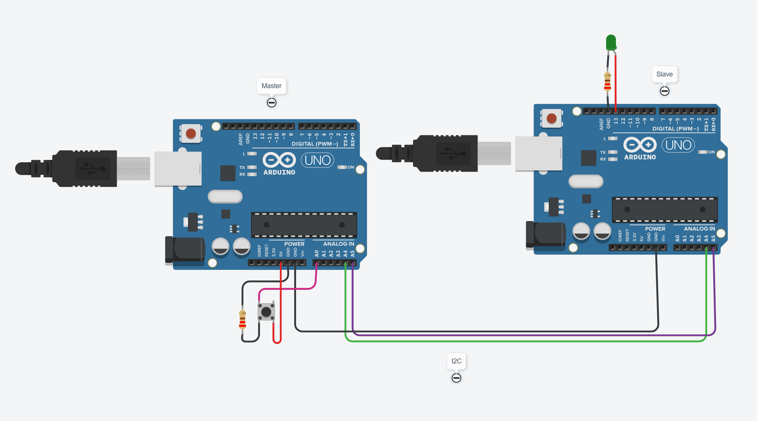
Circuit Diagram :

Slide 6
Circuit Connection :
STEP 1 : Connect A4 of Arduino 1 to A4 of Arduino.
STEP 2 : Connect A5 of Arduino 1 to A5 of Arduino
STEP 3 : Connect ground pin of Arduino 1 to ground pin of Arduino
STEP 4 : Connect push button:
Terminal 2a to 5V
Terminal 1a to ground through resistor
Terminal 1b to A0 of Arduino 1
STEP 5 : Connect LED Light:
Anode to pin 13
Terminal 2 to ground of Arduino 2.

Slide 7
Working Principle :
The working principle of the I2C (Inter-Integrated Circuit) communication involves a master-slave architecture where one device (master) initiates communication and controls the data transfer between itself and other connected devices (slaves).
Master and Slave Configuration:
Master Device: The device that initiates and controls the communication.
Slave Devices: Devices that respond to the master's commands and share data.
Serial Communication:
I2C uses a two-wire serial communication protocol: SDA (Serial Data Line) and SCL (Serial Clock Line).
SDA carries the actual data, while SCL is a clock signal used to synchronize the data transfer.
Start and Stop Conditions:
The communication begins with a START condition initiated by the master and ends with a STOP condition.
A START condition is a HIGH-to-LOW transition on the SDA line while the SCL line is HIGH.
A STOP condition is a LOW-to-HIGH transition on the SDA line while the SCL line is HIGH.
Addressing:
Each slave device on the bus has a unique address.
The master initiates communication with a specific slave by sending its address during the START condition.

Slide 8
5.Data Transfer:
Data is transferred in 8-bit bytes, with each byte followed by an acknowledgment bit.
Both master and slave devices can send or receive data.
The master generates the clock pulses on the SCL line, controlling the timing of data transfer.
6.Acknowledgment:
After receiving each byte of data, the receiver (either master or slave) sends an acknowledgment (ACK) bit.
If the ACK bit is not received, it indicates an error, and communication may be terminated.
7.Repetition of START and STOP Conditions:
After a data transfer, the master can repeat the START condition to communicate with another slave without releasing control of the bus.
8.Working at Both Edges:
I2C operates with clock transitions at both the rising and falling edges.
Data is sampled at the middle of each bit period, providing flexibility in terms of data rates.
9.Bi-directional Communication:
Both master and slave devices can initiate data transfer, making I2C a bidirectional communication protocol.

Slide 9
Code Implementation :
Master Code:
The master reads the state of a push button connected to pin A0.
It begins an I2C transmission to the slave device with the address 4.
The state of the push button is sent to the slave using Wire.write(x).
The transmission is ended, and there's a delay of 500 milliseconds before the next iteration.
Slave Code:
The slave begins the I2C communication as a slave with the address 4.
It sets up an onReceive event handler function named receiveEvent.
The LED on pin 13 is controlled based on the received data. If the received value is 1, the LED is turned on; otherwise, it's turned off.
The loop() function contains a delay, and the main purpose of this code is to respond to I2C data received from the master.

Slide 10
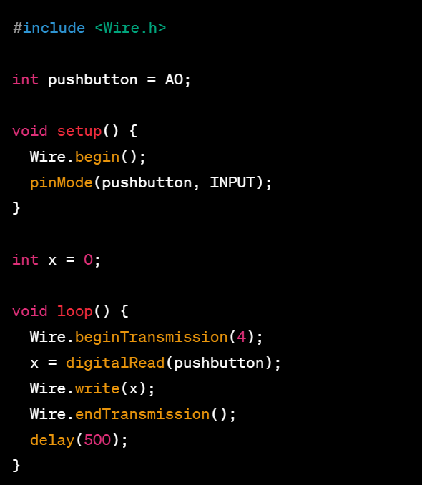
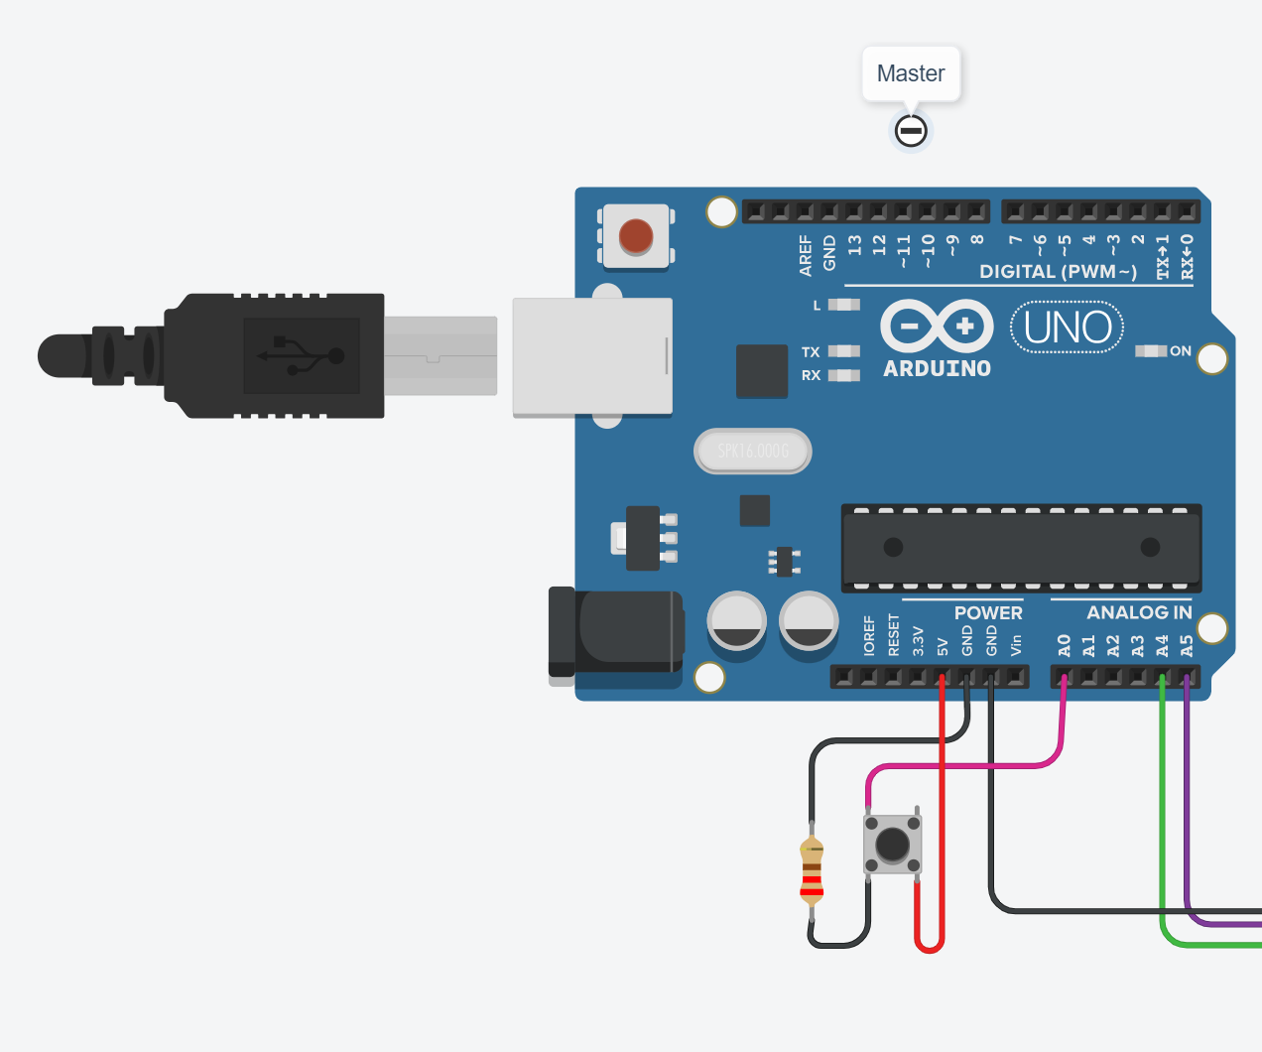
Code Implementation of Master :

Slide 11
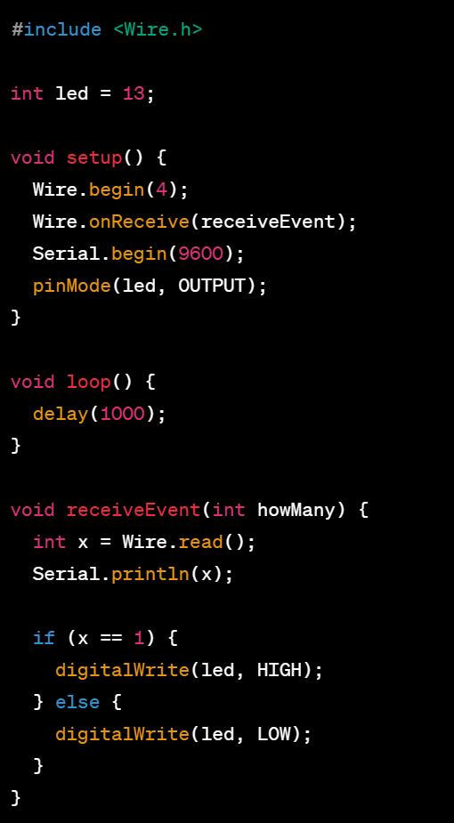
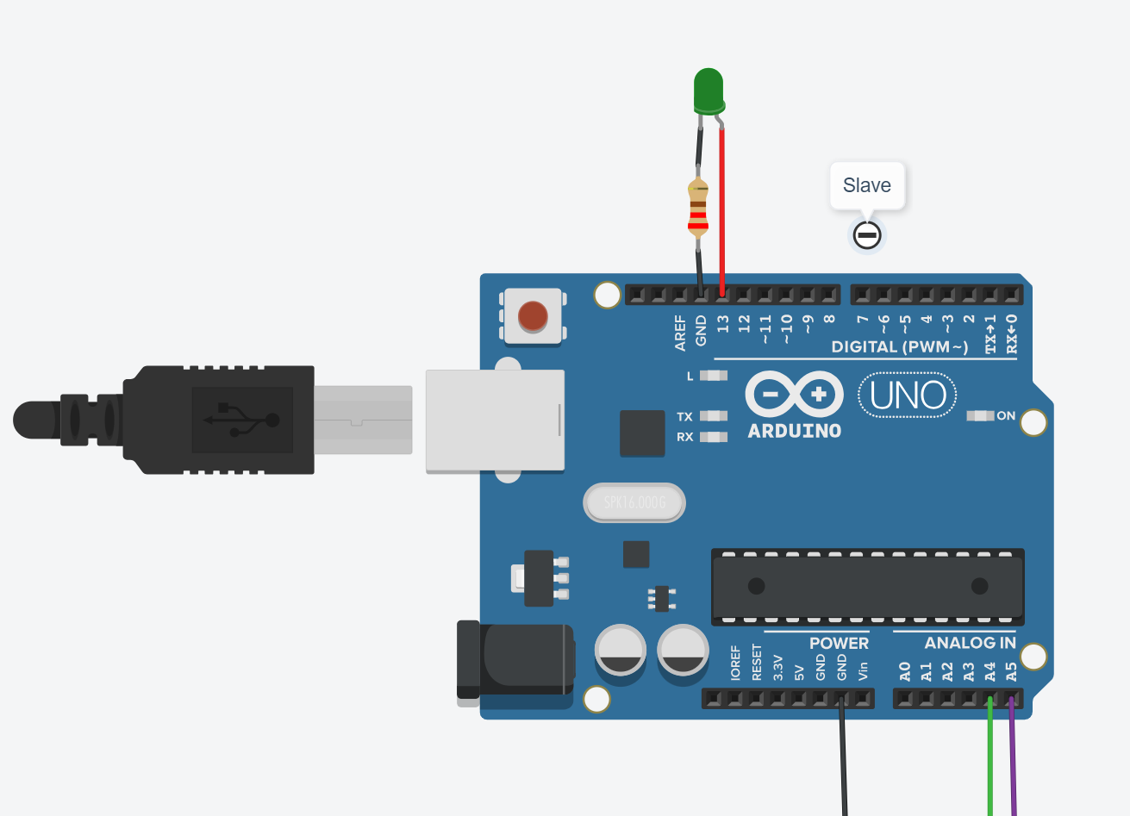
Code Implementation of Slave:

Slide 12
Testing and Results :
The AIM is to establish I2C communication,Components include 2 Arduino boards, LED, push button, and resistors.
Open the serial monitor in the Arduino IDE for the slave Arduino to monitor the received data,Press the push button on the master Arduino, and you should see the LED on the slave Arduino turn on and off accordingly. successfully created a simple two-way communication system using I2C between two Arduino boards.

Slide 13
Conclusion:
I2C communication project with Arduino serves as a practical exploration of inter-device communication. By employing two Arduino boards, an LED, and a push button, we delved into the intricacies of connecting devices and facilitating data exchange. This hands-on experience not only enhances our understanding of I2C protocols but also lays a foundation for more complex electronic applications. The project highlights the significance of seamless communication between devices, a fundamental aspect of modern electronics. The ability to control an LED through I2C showcases the practical implications of this technology, paving the way for further innovation in the realm of electronic communication. Overall, the project provides valuable insights into the practical implementation of I2C communication and its potential applications in diverse electronic systems.

Slide 14
References:
How to Setup I2C Communication on the Arduino - Circuit Basics
Arduino & Serial Peripheral Interface (SPI) | Arduino Documentation
https://youtu.be/PnG4fO5_vU4?si=rjxfDcB6ye_ajl2b
https://youtu.be/NVWJ_FiP0ZI?si=p1KeLlSyA11oYGHF

Slide 15
THANK YOU

